Slide 1

Ideation & Creation:
An Introduction
!
Notes:
Entrepreneurs: the impact-driven, change-making self-starters with an exponential vision for the world.
“Logic will get you from A to B, but imagination will take you everywhere.” – Albert Einstein
Jim Whales, Wikipedia story
Ellie Symes, Bee Corp

Slide 2
Be a definite optimist
Notes:
Peter Thiel’s Zero to One

Slide 3
Definite
Indefinite
- Future will be better than today
- “I have a vision & a plan that will make the future better”
- Future will be better than today
- “I’m sure we’ll think of something to solve climate change”
Optimism
- Future is bleak
- “I have ideas to make the world better but the future is bleak anyway”
- Future is bleak
- “I have no ideas & the future is bleak anyway. Why try?”
Pessimism
Notes:
Don’t get enamored with the process and incremental changes that leads to a profitable market-fit…
Think big, and be bold

Slide 4
Cultivate a growth mindset
Notes:
Carol Dweck’s Mindset

Slide 5
Mindset
Fixed
Intelligence believed to be static
We are born with Talents/Abilities
Desire to look smart & be right
Gives up easily
Sees effort as fruitless
Is offended by feedback & ignores it
Threatened by the success of others & feels insecure
Growth
Intelligence can be developed
Talents/Abilities can be developed through taking on challenges
Desire to learn
Embraces challenges
Persists through setbacks & obstacles
Learns from feedback
Finds lessons & inspiration from the successes of others
Notes:
We can’t be in growth mindset all the time, sometimes we revert back to a fixed mindset when we hear about a certain person or thing.
Ask the membership: What are some instances you slip into a fixed mindset? Is it a person, place, or memory? Why?
How can we flip that instance around to exist in a growth mindset?
Use personal example of Math LD and Unity

Slide 6
Don’t just question assumptions… Go further and actually test whether the opposite is true

Slide 7
First Principles
Assumptions:
Battery packs are expensive and cost $600 per kilowatt hour, besides that the price won’t get better anytime soon.
Fundamental Truths:
What are the materials the battery is made from? How much do those materials cost to buy and combine?
Cobalt, nickel, aluminum, carbon, polymers, a seal can
$80 per kilowatt hour
Notes:
Use example of John Adams, Elon Musk
Assumptions are examples of what?... fixed mindset, definite pessimism
What are some assumptions you have?

Slide 8
Creative Exercise (5 min)
How might we improve the airport security experience?

Slide 9
“Imagination is more important
than knowledge.
Knowledge is limited to all we now know and understand, while imagination embraces the entire world.”
Albert Einstein
Notes:
Goes back to Peter Thiel’s commandment to think big, pursue an exponential vision

Slide 10
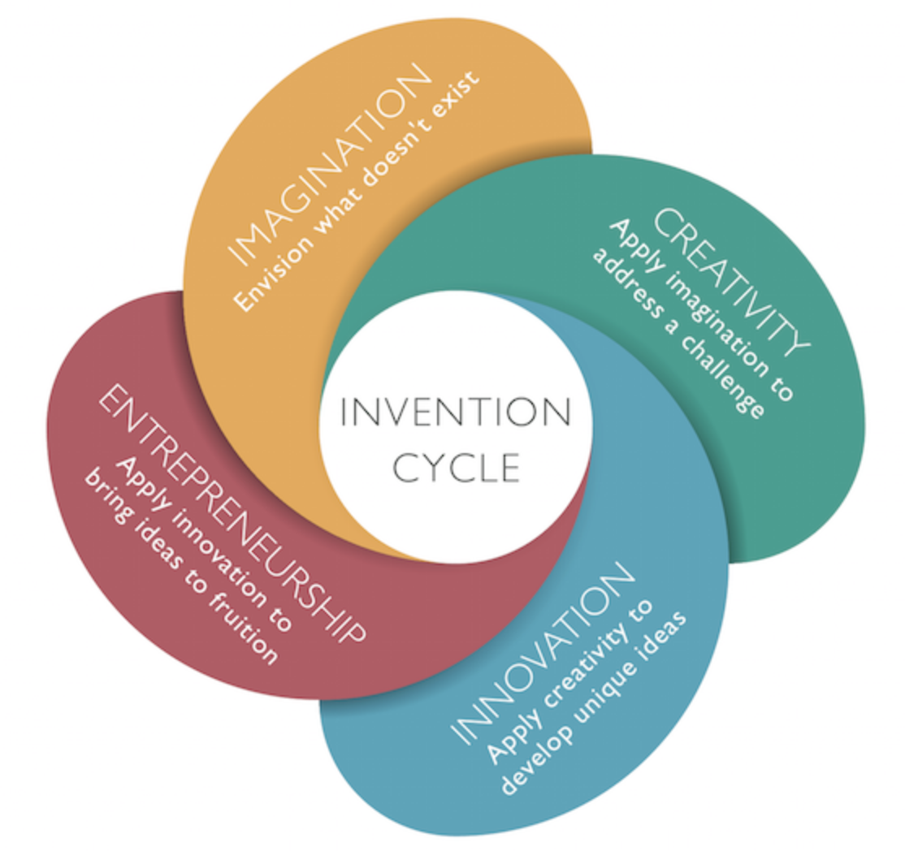
The Invention Cycle
Notes:
Imagination → Creativity → Innovation → Entrepreneurship

Slide 11
People
Business
Technology
Innovation
Notes:
People: are the human needs being considered and met?
Tech: is this tech feasible or possible to create?
Business: is it profitable and affordable?
Ask for examples of companies that have done all three:
Apple
Uber/Lyft
Airbnb

Slide 12
Creative Exercise (8 min)
Take a piece of paper and write down the first 10 things that come to mind.
Compare your list with the person next to you, and see if anything from your combined lists could combine to solve a current need.

Slide 13
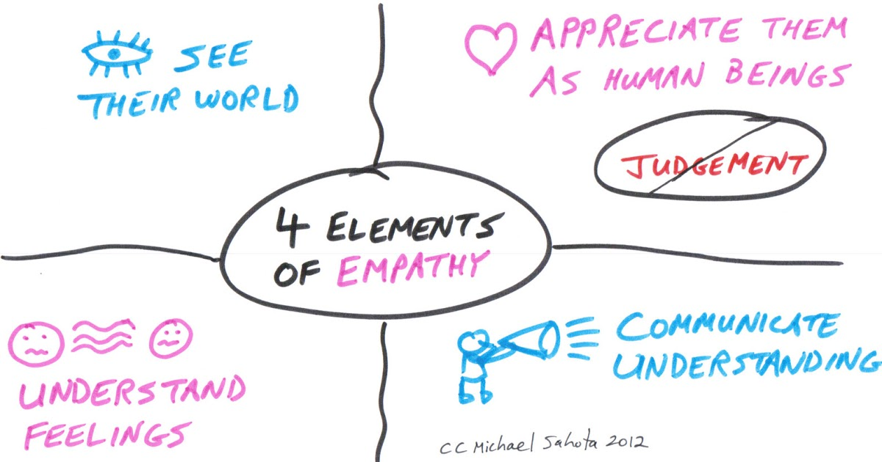
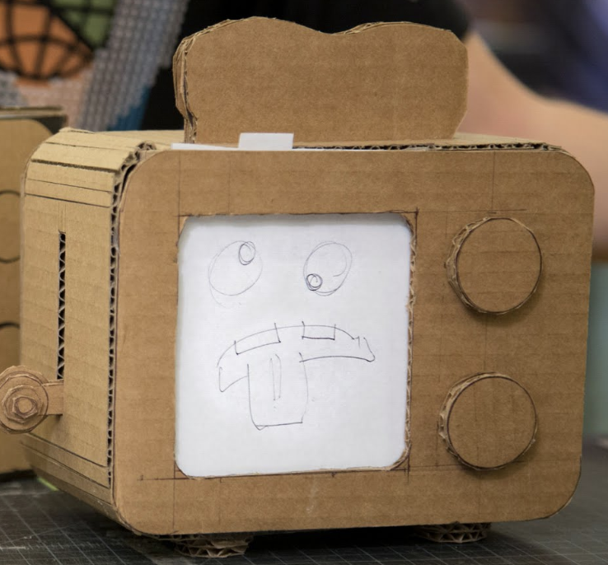
IDEO Methodology
Empathize
Define
Ideate
Prototype
Test
Notes:
Interact & connect, be open to a need that hasn’t been met yet
Recognize patterns/define themes, find meaning that you can draw insights from
Sketch, write, brainstorm -- whatever it takes to get a volume of ideas out from the insight(s)
Look at your volume of ideas and ask yourself, “How might this idea solve for the original need?”
“Is this idea the best way to solve for the original need?” “Is there a better idea to solve for the need?”
After reflecting and selecting your idea, create a physical prototype for your solution
Share your prototype and observe how people interact with it… that will give you the most valuable feedback and insights

Slide 14
“Quantity is the most predictable path to quality.”
Adam Grant
Notes:
Adam Grant’s Originals
Iterate on the prototype with the user feedback and user interaction w/ the prototype.
(insert stat from book)

Slide 15
“All of us are smarter than any of us.”
IDEO
Notes:
COMMUNITY IS KEY -- USE EACH OTHER AS CATALYSTS FOR IMAGINATION AND ACTION
ICE & the Innovation Center are great communities for this.

Slide 16
Resources
“Creative Confidence: Unleashing the Creative Potential Within Us All”, by David M. Kelley & Tom Kelley of IDEO (world’s leading design firm)
“Mindset: The New Psychology of Success”, by Carol S. Dweck (Stanford)
“Originals: How Nonconformists Move the World”, by Adam Grant (Wharton School of Business)
“Zero to One”, by Peter Thiel (Paypal Mafia, Palantir, VC)
“inGenius: A Crash Course on Creativity”, by Dr. Tina Seelig (Stanford, consults for the Big Four & more)
https://startupiu.sice.indiana.edu/
Powderkeg Podcast -- The Untold Stories of Innovation, Leadership, and SaaS Beyond Silicon Valley (based in Indy, hosts Startup Mic Night)
Notes:
COMMUNITY IS KEY -- USE EACH OTHER AS CATALYSTS FOR IMAGINATION AND ACTION
ICE & the Innovation Center are great communities for this.

Slide 17
Whatever You Do, Just Don’t Be This Basic
http://www.itslikeuberfor.com/
https://thebolditalic.com/this-is-your-life-in-silicon-valley-933091235095
https://thebolditalic.com/this-is-your-life-in-silicon-valley-two-years-later-8651001e3ff8

Slide 18
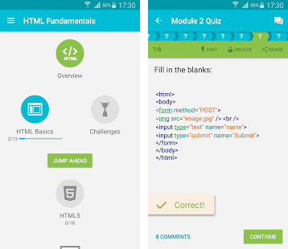

App of the Week
SoloLearn
FREE!

